Slide 1
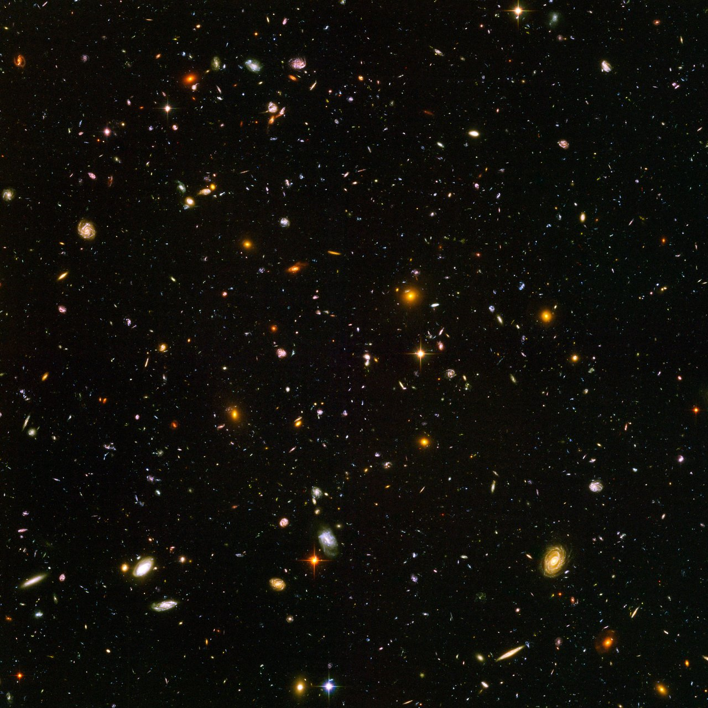
Analyzing Star-Galaxy Separation Methods for SKYSURF
Andi Swirbul
Mentors: Rogier Windhorst, Timothy Carleton, Seth Cohen
Arizona Space Grant Symposium
April 23, 2022

Slide 2
Background
Despite appearing dark to our eyes, our view of the night sky is dominated by foreground light from dust within our Solar System and galaxy.
SKYSURF seeks to utilize HST’s powerful imaging capabilities to gain a better understanding of the low surface brightness Universe behind this foreground.

Slide 3
Project Goals
This project assists ongoing efforts in the program by analyzing various methods for star-galaxy separation within the SKYSURF dataset.
The goals of this project include:
Creating a program to optimize the procedure for star-galaxy separation
Testing the accuracy of the program
Applying the program across the entire SKYSURF dataset

Slide 4
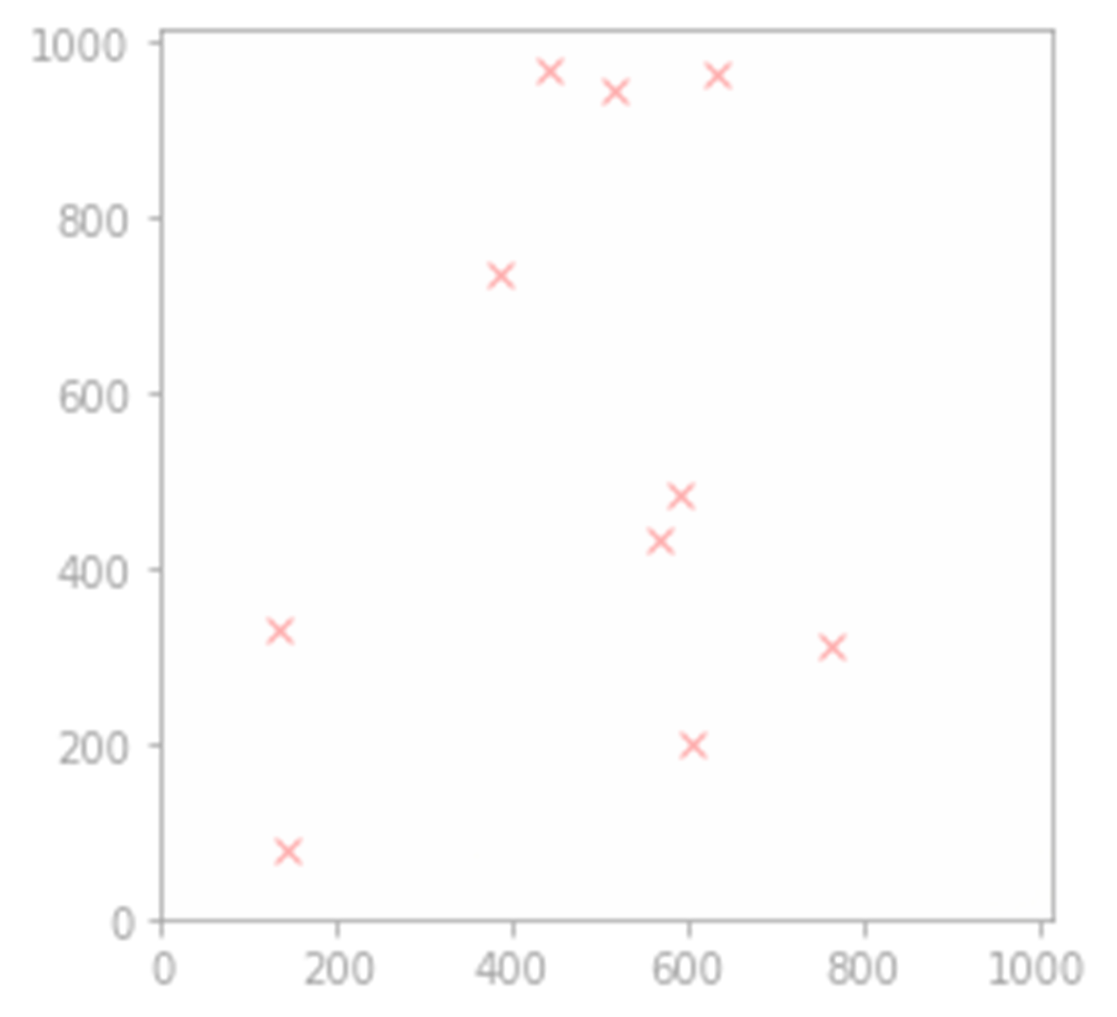
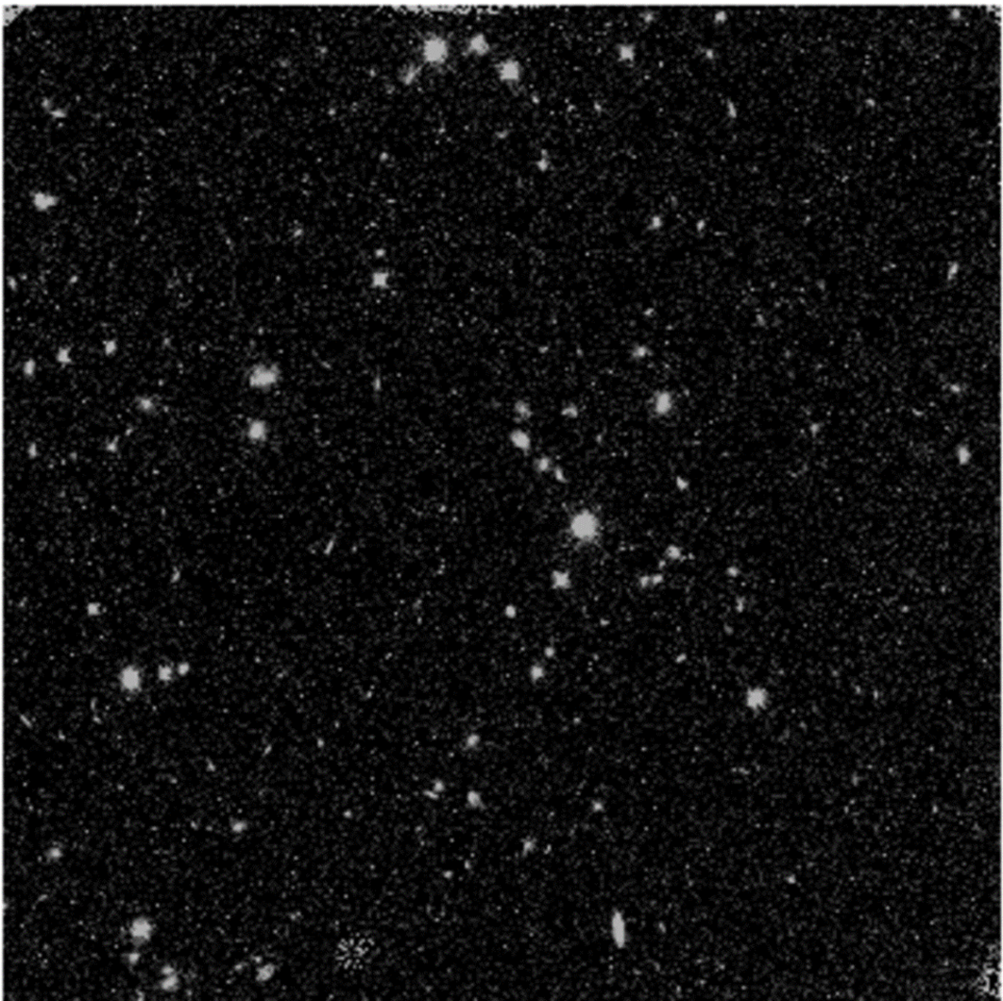
Methods & Results
Stellar catalogs were created for each image, and then crosschecked against verified stars from the Gaia stellar survey.
In addition, Source Extractor was run on the images to check the program’s validity.

Slide 5
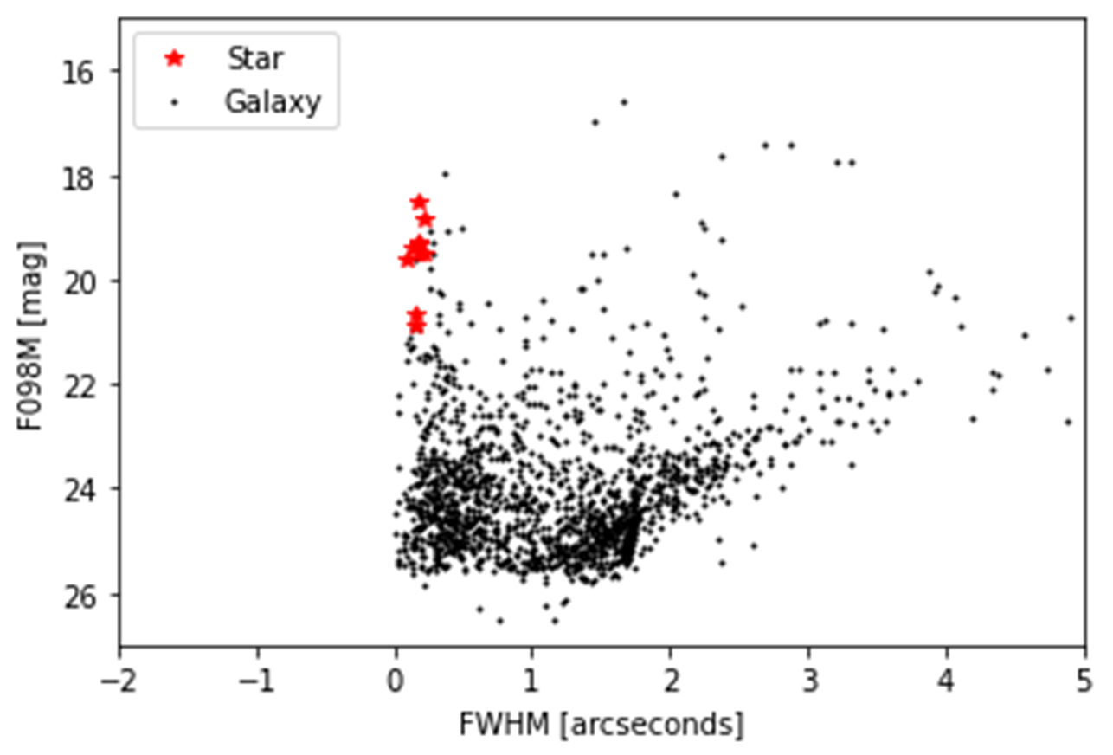
Methods & Results
Stars and galaxies were also compared based on their full width at half maximum, as shown in the plot to the right.
As can be seen, stars tend to have a larger apparent magnitude and a smaller FWHM than most galaxies, making this technique a fairly effective way to distinguish between stars and galaxies.

Slide 6
Future Goals
Expand the work to the remaining filters in the SKYSURF dataset
This includes:
Analyzing the accuracy of the stellar catalogs
Reproducing the magnitude-FWHM diagram for random images across the other filters with a goal of determining whether full width half maximum can be used to accurately distinguish between stars and galaxies within the SKYSURF dataset

Slide 7
Thank You!

